Slide 5
Constraint Branching is the Solution?
For
Similar branching for Special Ordered Sets (SOS)
SOS1:
SOS2:
Implemented by Gurobi and CPLEX

Slide 6
Effectiveness of SOS Branching in Practice
Very sensitive to implementation of advanced branching techniques

Slide 7
Multiple Choice Plus SOS1 Constraints
MC Formulation:
Plus SOS1 over
SOSMC: keep integrality of y
SOSMCNB: relax integrality of y

Slide 8
Effect of SOS1 Constraints: Solve Time
Gurobi 6.5 on Core i7-3770 (3.40GHz), 32 GB RAM.
Limit: 1000s (average over 5 instances)

Slide 13
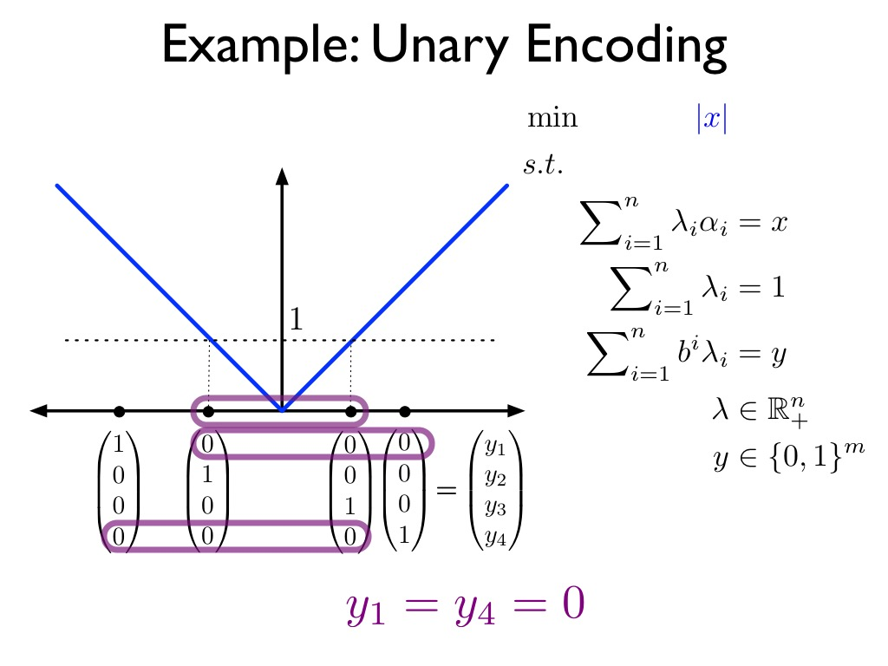

Slide 17
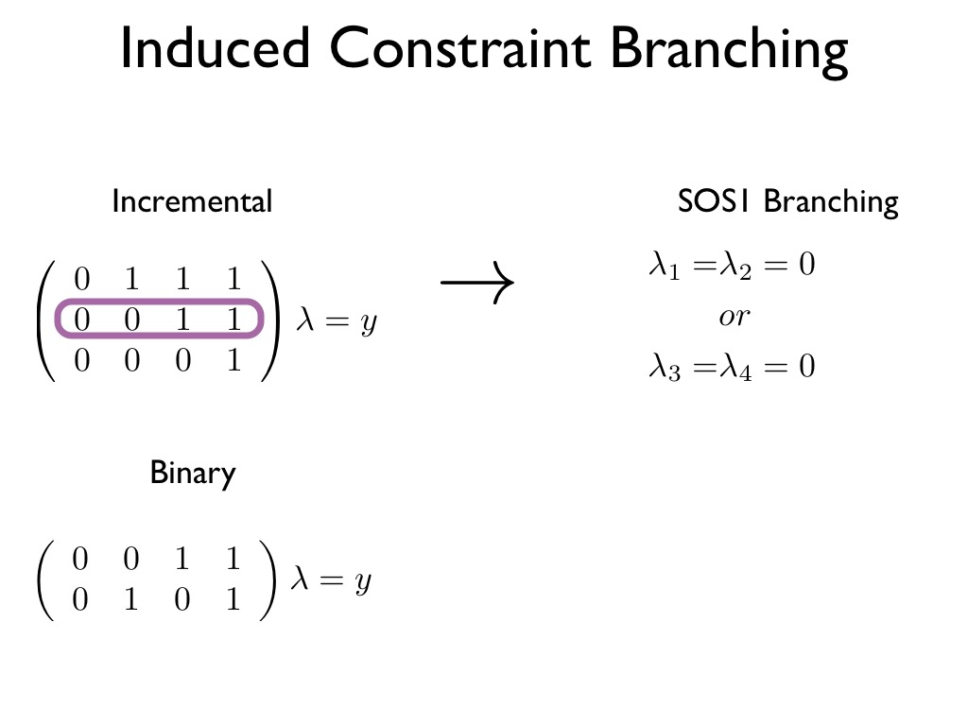
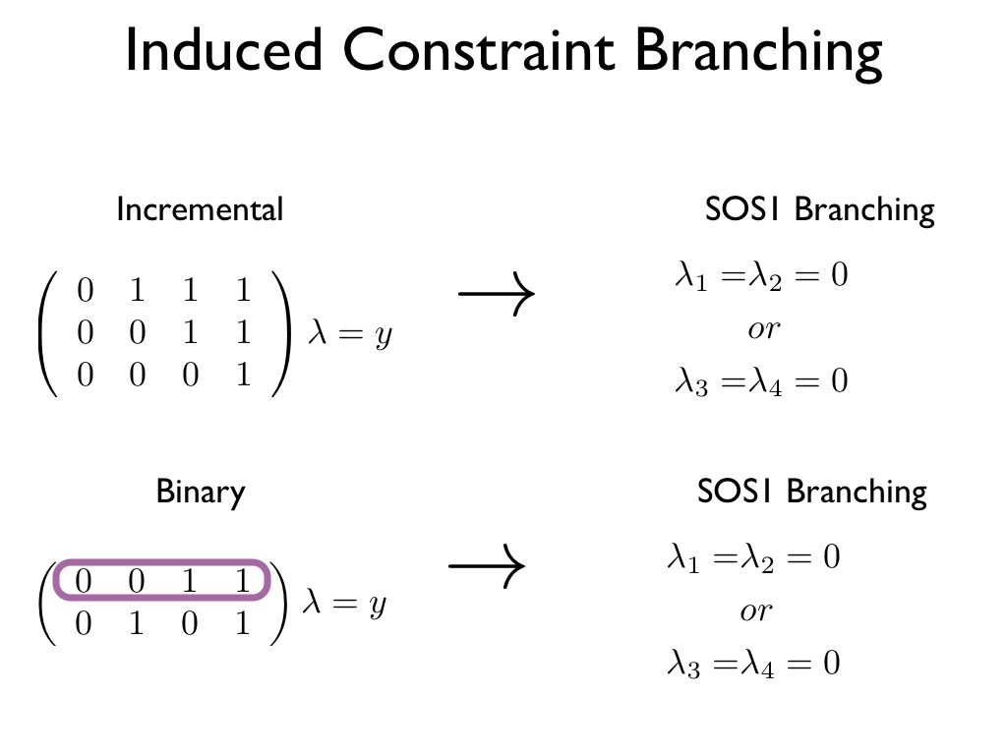
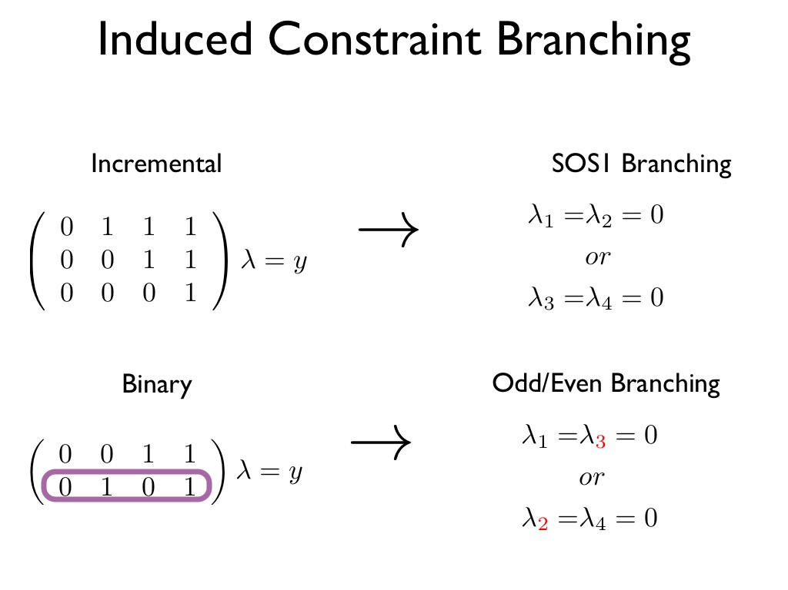

Slide 18
Multiple Choice Plus Encoding
MC Formulation:
Binary encoding (MCBin)
Incremental encoding (MCInc)

Slide 19
Effect of Encoding Constraints: Solve Time
Gurobi 6.5 on Core i7-3770 (3.40GHz), 32 GB RAM.
Limit: 1000s (average over 5 instances)

Slide 22
DCC Formulation:
DCC + Encoding
Binary encoding (DCCBin)
Incremental encoding (DCCInc)

Slide 23
Effect of Encoding Constraints: Solve Time
Gurobi 6.5 on Core i7-3770 (3.40GHz), 32 GB RAM.
Limit: 1000s (average over 5 instances)

Slide 24
Incremental Formulation: Inc
Affine transformation of DCCInc

Slide 25
Effect of Encoding Constraints: Solve Time
Gurobi 6.5 on Core i7-3770 (3.40GHz), 32 GB RAM.
Limit: 1000s (average over 5 instances)

Slide 26
Simple Formulation for Univariate Functions
Non-Ideal: Fractional Extreme Points

Slide 27
Advanced Formulation for Univariate Functions
Ideal: Integral Extreme Points

Slide 28
Formulation Improvements can be Significant
Simple
Advanced
GUROBI

Slide 29
Can we do even better?
Yes, by focusing on branching

Slide 30
More elaborate: SOS3(26)
SOS2 on Blocks of 3
Cover arcs
between adjacent blocks of 3

